Slide 1

Proposal and Feasibility Presentation
Urdu Caption For Blind Peoples
Sardar Badar Sahir, SP19-BCS-022
Irttisam Ali, SP19-BCS-058
Shaid Ali ,SP19-BCS-060
Department of Computer Science
COMSATS University Islamabad, Abbottabad Campus

Slide 2
Agenda of the Presentation
Motivation
Brief Introduction
Scope
Functionalities
Tools and Technologies
Feasibility
1. Technical
2. Resource
3. Financial
4. Operational
Conclusion

Slide 3
Motivation
In 2017 estimated more than 2.21 million [1] people in Pakistan are blind or has Sever Visual Impairment
They rely on people to help them navigate in the their surroundings
The traditional tools and techniques are not very useful since it takes a person to be available form them.
However, with the help of Urdu Voice Captioning Application they can do their daily tasks.

Slide 4
Brief Introduction
In Pakistan, people with visual impairment face many hurdles in performing day to day to task. They must have to estimate the state of the object. The project aims to manually develop Cross Platform application that can help blind people perform daily task.

Slide 5
Brief Introduction (cont.)
Our system is implemented in python and Cross-platform app. Detection system is implemented in python using libraries such as Keras and TensorFlow. The Detection and classifier we are using to detect the state of the object from the picture is VGG-16. Cross-platform will provide interface to user to interact with the System .

Slide 6
Connectivity
Our Cross platform application will use tflite library to established the connectivity between the model and app.

Slide 7
Scope
Cross-platform Based Application
This detection system scope is limited . Any source like cameras takes random pictures of objects and send to the model for checking result after processing the model it gives result.

Slide 8
Functionalities
Signup
Login
Capture Image
Generate Urdu Captions
Caption to speech

Slide 9
Proposed Tools/Platform
Tools | Version | Rationale
Android Studio/ Vs code | 4.1/1.50.1 | IDE
Firebase | Latest | Database
MS Power Point | Microsoft 360 pro plus | Presentation
Adobe XD | 32.0 | Designing Mockups
MS Word | Microsoft 360 pro plus | Documentation
MS Excel | Microsoft 360 pro plus | Project Management, Gantt chart
Python | 3.7 | Programming Language
MS Visio | Microsoft 360 pro plus | Diagramming Tool

Slide 10
Feasibility
Technical feasibility
All the mentioned Tools and Technologies are freely available.

Slide 11
Feasibility
Financial feasibility
Most of the tools and technologies we are using a freely available to us.
There is an app publishing fee of $25 dollars on Google play store and $99 for Apple store incase we publish it.

Slide 12
Feasibility
Resource feasibility
we always have the following resources available to us.
PCs/Laptops
Smart Phones
Working Internet Connection

Slide 13
Feasibility
Operational feasibility
Our app will require the users to have an android smart Phone connected to the internet
Which is normal now a days.
They need to be literate enough to use the Application.

Slide 14
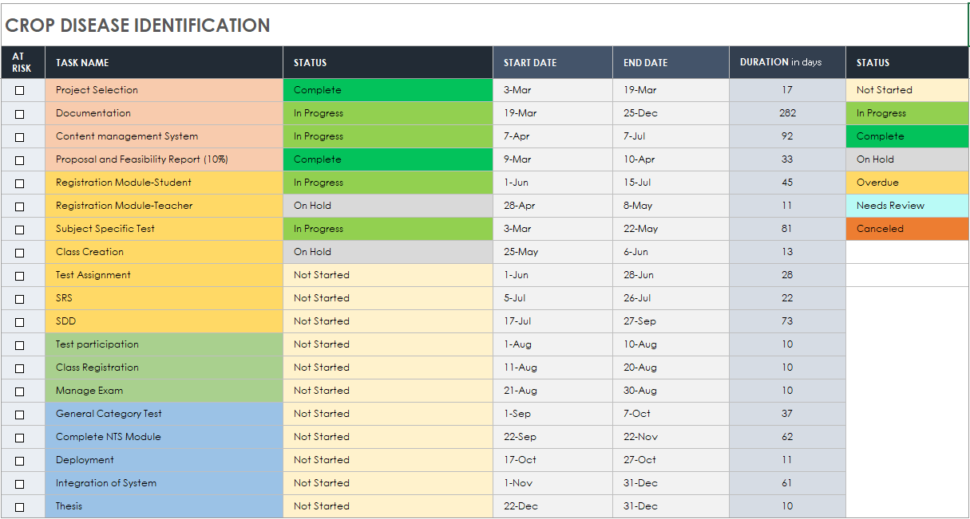
Schedule

Slide 15
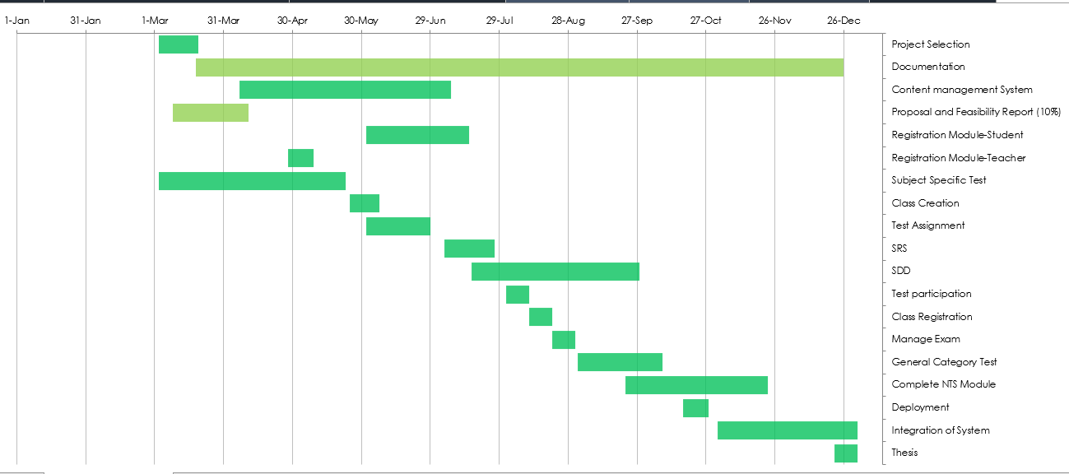
Schedule (Cont..)

Slide 16
Tasks for 1st Iteration (or 30%)
Documentation
Mockups
App Interface

Slide 17
Conclusion
Develop Cross platform Application to help visually impaired in recognizing in state of object. Testing methodology to a Android and IOS based service.

